Slide 1
<Project Name>
PROJECT KICK OFF Template
<PMO / Project Team>
<Kick-off Date>

Slide 2
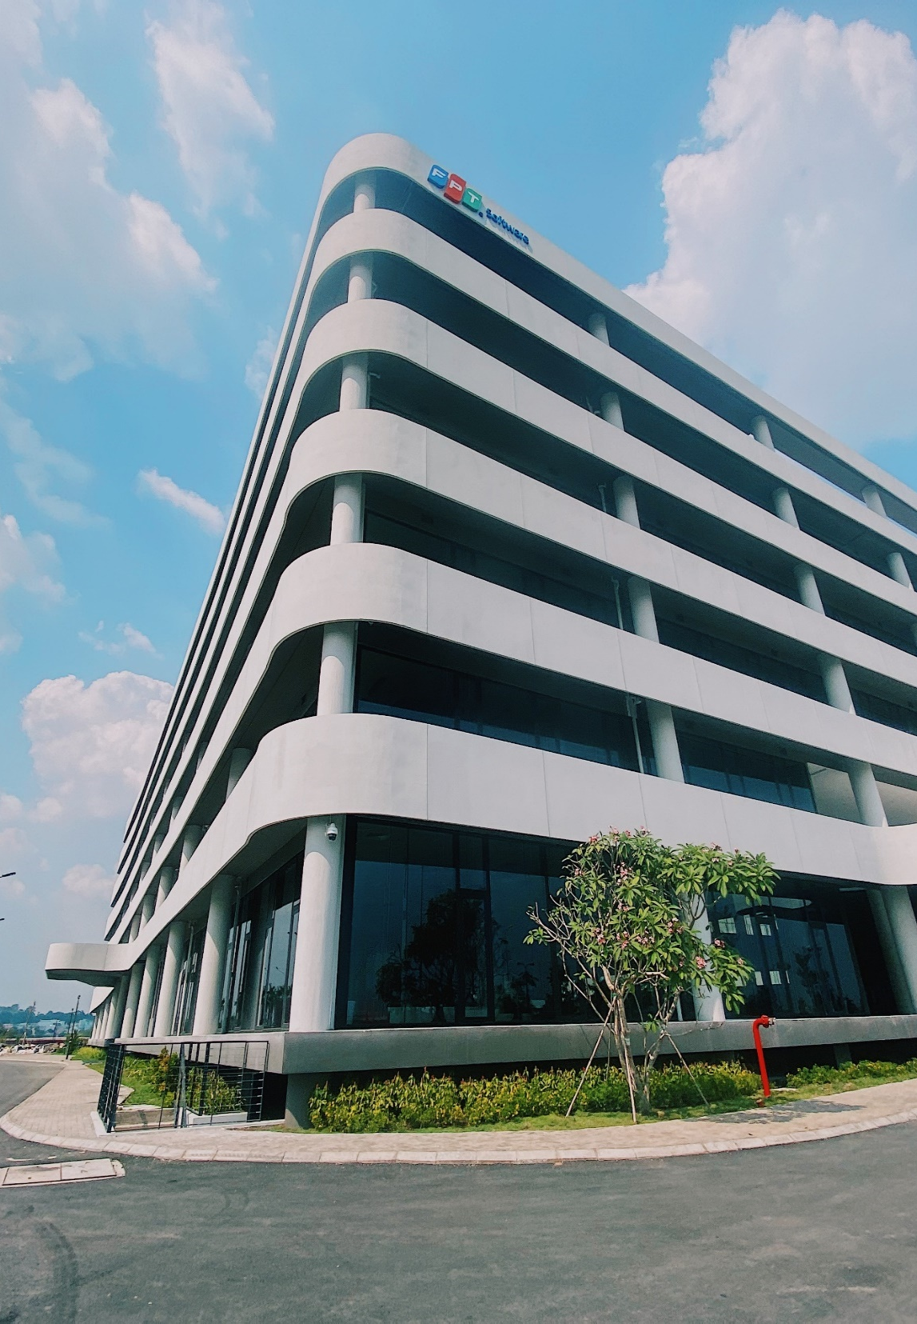
AGENDA
01
Project Overview
02
Project Management Approach
03
Process & Tools
04
Q&A

Slide 3
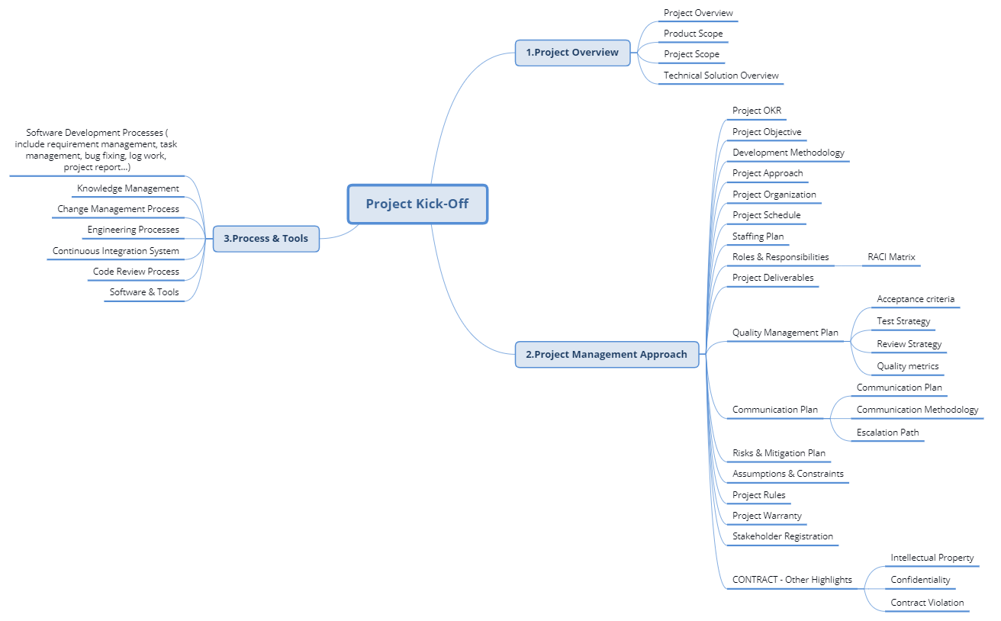
Slide Road map
Notes:
Service & domains: thêm ví dụ
Challenges: chỉ đưa external factor ảnh hưởng đến project, ko mention internal: communication skill, experience of project team

Slide 4
PROJECT
OVERVIEW
01

Slide 5


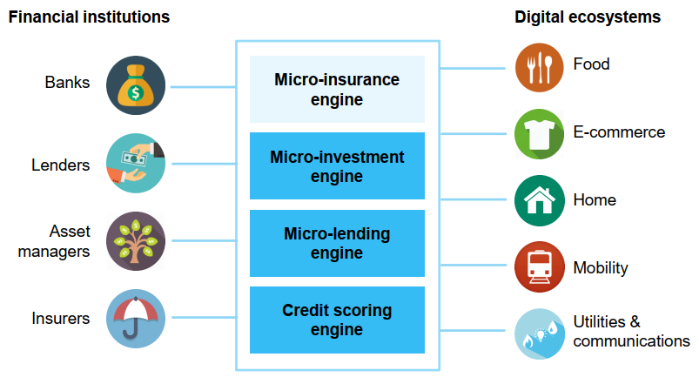
Product Overview
Notes:
Service & domains: thêm ví dụ
Challenges: chỉ đưa external factor ảnh hưởng đến project, ko mention internal: communication skill, experience of project team

Slide 6
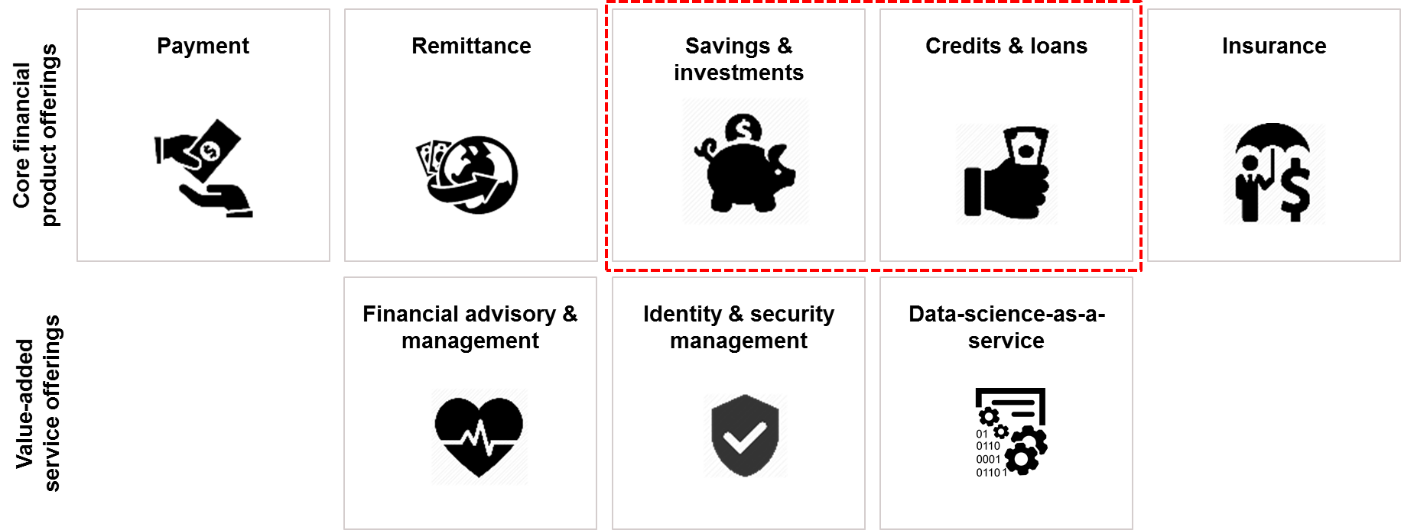
Product Scope - Background

Slide 7




Project Scope
  BMM: <BMM>
    Onsite: <Onsite MM>
    Offshore: <Offshore MM>
  Cost: <Cost>
  Start date: <Start Date>
    BD: <BD Date>
    DD~IT: <DD~IT Date>
    ST: <ST Date>
  End date: <End Date>
  Backend: <Backend tech stack>
  Frontend: <Frontend tech stack>
  Compatible Browser: <Compatible Browser>
Cost
Milestone
Tech Stack
  Total LOC: <Total LOC>
  Screen: <Screen count>
  Report: <Report count>
  Batch: <Batch count>
  IF: <IF count>
SRS definition
Deployment
Operation Design
SRS analysis
ST
Migration DB
BD
IT
User training
DD
UT
Coding
(baseline <YYYY-MMM>)
End User
Customer
Customer & FPT
FPT
Scope

Slide 8
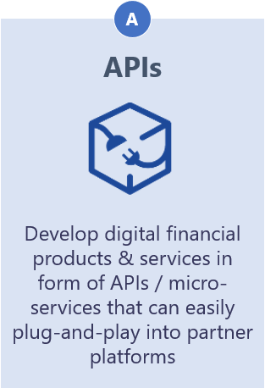
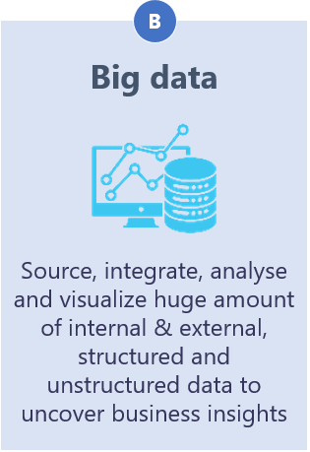
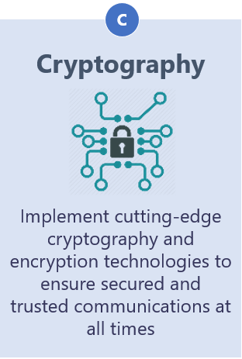
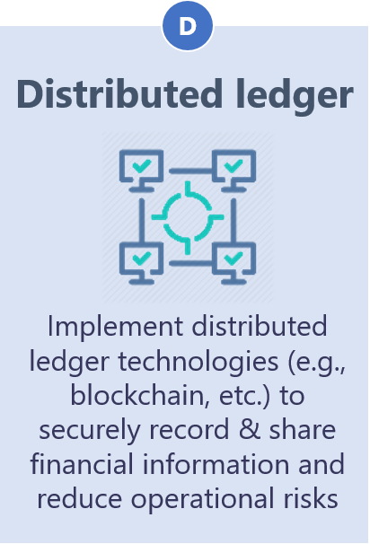
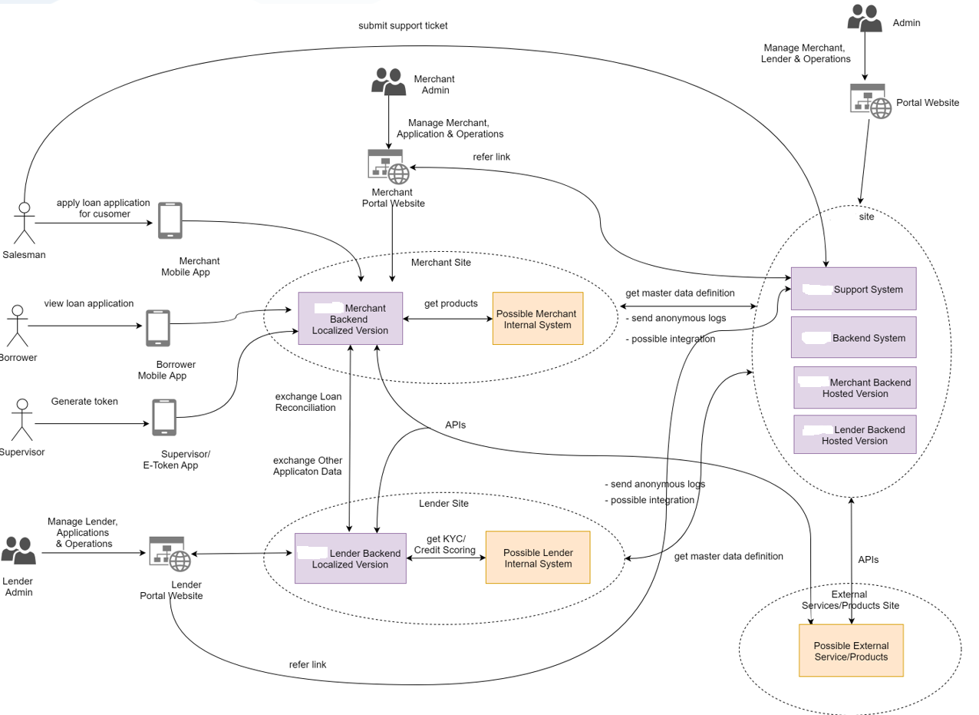
Technical Solution Overview

Slide 9
02
Management
Approach

Slide 10
Project OKR
<Project OKR statement, e.g., To become the best-run project managing a team of X members by YYYY>
THE BIGGEST TEAM
CUSTOMER SATISFACTION
<Team ramp-up target>
<Go-live milestone target>
<CSAT target> point
<No-complaint target/level>
HAPPY WORKING PLACE
PROFESSIONAL TEAM
<% members happy target>% members happy with Program
Attrition Rate: <Target>%
<English competency targets>
<Certification targets>
INNOVATION
<Number of IPs target>

Slide 11
Project Objectives
<Metrics as required by customer, organization, project specifics>
# | Metrics | Unit | Target | Basic for setting Goals
Quality
1 | Customer Satisfaction | Point | <Target> | 1. <Refer customer metrics> 2. <Refer to FSU target in year YYYY, y% higher than previous project (A project)> 3. < Refer old projects>
2 | Leakage | Def/MM | <Target>
3 | Process Compliance | % | <Target>
Cost
4 | Effort Efficiency | % | <Target>
5 | Correction Cost | % | <Target>
6 | Internal Defect Rate | Def/size | <Target>
Delivery
7 | Timeliness | % | <Target>
8 | Project Productivity | KLOC/ MM | <Target>

Slide 12
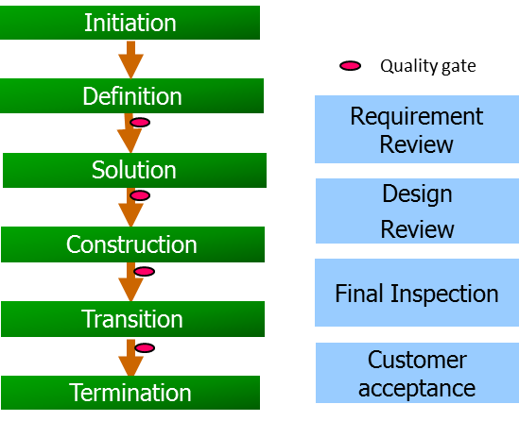
Development Methodology

Slide 13





Project Approach
Basic Design
Detail Design ~ IT1
IT2
ST
UAT
c
SYSTEM
Development Roadmap
Quality Strategy
Consolidate planning, monitoring and control: estimation, schedule, progress, metrics
Project Scope
Metrics
Product Management
Productivity Strategy
PMO Team
Progress
Continuous Exploration
Continuous Integration & Deployment
Continuous Release
ITERATION/SERVICE GROUP
Iteration Scope
System common scope
1. Planning for iteration
2. Develop/Maintain System Design, Database Design, FW & System Common
3. Develop/Maintain Test Plan
1. Continuous integration (service level)
2. Internal acceptance test of module delivery
1. External release by service completeness
(5 service groups)
Schedule
Tech Team
Service common scope
Initiation
Solution
Construction
Transition
Maintenance
PROCESS/MODULE
Estimation
Module Scope
(5 service groups x 5 module teams)
1. Evaluate Basic Design
2. Re-estimate
3. Create Schedule
4. Build team
1. Define solution + Create High-level design
2. Brush-up BD
3. Develop common modules
1. Update Basic Design (if any)
2. Create Detail Design, Coding, UT
3. IT1 (module-level)
1. Internal release by module completeness
2. Fix bugs from internal acceptance test
1. Apply horizontal – deployment (TKN)
2. Fix bug (if any)
Consolidate
Screen/ Report/ Batch/ IF
Module common scope
Development Team
Unified Process & Template& Checklist
Unified Target Metrics
Common Management Framework
Common Training Program
Centralized CICD

Slide 14
Project Iteration Process

Slide 15
Project Organization
Customer
FPT Onsite
FPT Offshore
STEERING COMMITTEE
Project Director/ Senior Manager
<ABC>
Account Manager
<ABC>
Project Director/ Senior Manager
<ABC>
PROJECT DELIVERY
Delivery Manager
<ABC>
Project manager
<ABC>
Project Manager
<ABC>
Dev Team 1
<ABC>
Dev Team 2
<ABC>
Dev Team 3
<ABC>
Dev Team 4
<ABC>
Technical Owner
<ABC>
Technical Solution
<ABC>
Test team
<ABC>
Infrastructure Owner
<ABC>
PMO
<ABC>
QA
<ABC>

Slide 16
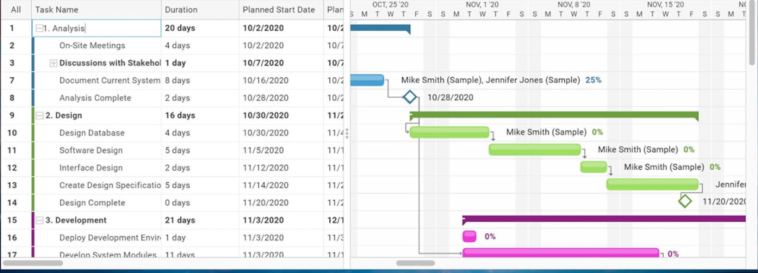
Project Schedule
<Add your master schedule/project schedule here>

Slide 17
Staffing Plan
Resource | Mar |  | Apr |  | May |  | Jun |  | Jul
 | P | A | P | A | P | A | P | A | P | A
Dev | 0 | 0 | 0 | 0 | 0 | 0 | 0 | 0 | 0 | 0
Test | 0 | 0 | 0 | 0 | 0 | 0 | 0 | 0 | 0 | 0
Technical Solution | 0 | 0 | 0 | 0 | 0 | 0 | 0 | 0 | 0 | 0
Project Manager | 0 | 0 | 0 | 0 | 0 | 0 | 0 | 0 | 0 | 0
Total | 0 | 0 | 0 | 0 | 0 | 0 | 0 | 0 | 0 | 0

Slide 18
Roles and Responsibilities
# | Role | Responsibilities
1 | <Customer> Project Director/ Senior Manager | Make critical business decisions to project’s success. Approve scope and budget for the project.
2 | <Customer> Project Manager | Responsible for ensuring support. timely response and timely decision from <Customer>. Responsible for prioritizing works for FPT Escalation point for handling challenges/slowness from <Customer> side on dependencies, approval…
3 | <Customer> Technical Owner | Technical requirement walkthrough with FPT Responsible for responding on technical questions from FPT team Review and approve technical solution of automated test scripts
4 | <Customer> Infrastructure Owner | Provide needed license , tool, library for FPT to setup environment Support to resolve all dependencies relate to software, hardware…

Slide 19
Roles and Responsibilities
# | Role | Responsibilities
1 | FPT Project Director/ Senior Manager | Make critical business decisions to meet customer expectation. Develop scope and budget for the project.
2 | FPT Project Manager | Develop a detailed project plan to monitor & control across project. Developing project scopes and objectives, involving all relevant stakeholders and ensuring technical feasibility. Ensure that all projects' requirements are delivered on-time, within scope and within budget. Control Project's Quality across project. Ensure resource availability and allocation Report and escalate to management as needed Manage the relationship with the client and all stakeholders Perform risk management to minimize project risks Create and maintain comprehensive project documentation
3 | FPT Development Team | The team includes Development Lead, Developer who are responsible for developing and delivering product to customer.
4 | FPT Testing Team | Overall responsible for the quality of product Develop Test Cases, execute test cases (manual or automated) and analyze results Evaluate product code according to specifications Create logs to document testing phases and defects Report bugs and errors to development teams Conduct post-release/ post-implementation testing Work with cross-functional teams to ensure quality throughout the software development lifecycle
5 | FPT PMO Team | Set up the Management framework for Project Provide guideline/template on project activities Train/guide team understand about process, templates to make sure team know and follow

Slide 20
Roles and Responsibilities - RACI Matrix Sample
Sample :
 | Deliverable Item | Client | Customer | FPT BD | FPT DD~ST
Detail Design | Common Function List | R | A/R | R/C | DP
 | Common Function Specs Document | R | A/R | R/C | DP
 | Physical Data Model | I | A/R | R/C | DP
 | Program List | R | A/R | R/C | DP
 | Program Specs Document (Screen, Report, Batch) | R | A/R | R/C | DP
 | Overall Test Plan | R | A/R/C | DS | DP
Coding/UT | Program Specs Document | I | R/C | C | A/R/DP
 | JAVADOC | I | R/C | C | A/R/DP
 | UT Test Plan | O | I | R/C | A/R/DP
 | UT Spec Document | O | I | R/C | A/R/DP
 | UT Test Report | I | I | R/C | A/R/DP
 | Test environment preparation | O | O | I | DP
IT Test | IT Test Plan | I | R/C | C | A/R/DP
 | IT Test Specs Document | I | R/C | C | A/R/DP
 | IT Test Report | I | R/C | C | A/R/DP
 | Test environment preparation | O | O | DP | DP
ST Test | System Test Plan | R | A/R/C | R/DS | DP
 | System Test Spec Document | R | R/C | R/DS | A/R/DP
 | System Test Report | R | A/R/C | DP | DS
 | Test environment preparation | I | DP | DS | DS
RADIO | Description
A | Approver
R | Reviewer
DP | Doer Primary
DS | Doer Secondary
C | Consult
I | Inform
O | Omit (Blank)

Slide 21
Project Deliverables
# | Phase | Release Name | Release Scope | Items | Release Date | Acceptance criteria
1 | DD~IT1 | Deliverable 1 | <Scope items - Deliverable 1> | <Detailed deliverable items - Deliverable 1> | <Release Date 1> | 100% Requirement is done (including coding, testing, and fixing bugs/defects and committed source code) as committed. No show stopper/ blocker defect Fix all comments of customer
2 |  | Deliverable 2 | <Scope items - Deliverable 2> | <Detailed deliverable items - Deliverable 2> | <Release Date 2>
3 |  | Deliverable 3 | <Scope items - Deliverable 3> | <Detailed deliverable items - Deliverable 3> | <Release Date 3>
4 | IT2 | Deliverable 4 | Finish IT2 | Software Package Integration Test spec and Test report | <Release Date 4>
5 | STC | Deliverable 5 | Finish ST case | System test spec | <Release Date 5>
6 | System Test | Deliverable 6 | Execute ST | ST specs ST report Software Package | <Release Date 6> | Fix all comments of client

Slide 22
Quality Management Plan – Acceptance Criteria
<Refer to Acceptance Criteria of project contract in FCMS>
Category | Product | Criteria
Product acceptance criteria | Test Case | 100% test coverage. Test cases must be reviewed and approved before testing
 | Source Code | 100% source code must be reviewed. 100% source code be scanned by Blackduck, SonarQ, Coverity.
 | Defect | 100% of Show Stopper/Must Fix defects must be resolved/closed. Zero obvious defects. <10% complicated defects.
Project acceptance criteria |  | 100% scope and deliverables are delivered on time as committed. No show stopper/ blocker defect. Approved by Client.

Slide 23
Quality Management Plan – Test Strategy
Test Type | Objective | Technique | Using Tool | Completion Criteria | Output
Function Test | Ensure proper target-of-test functionality, including navigation, data entry, processing, and retrieval. | Black box test technique will be used Test leader creates checklists for common features to support review and test execution Testers will create test scenarios against User Stories approved by customers Testers execute test based on test scenarios and make reports. Common defects will be collected for improvement checklists. | Manual Test Automation script (optional) | All planned tests have been executed. All identified defects have been addressed and closed | Test report
User Interface Testing | Verify a user’s interaction with the software Ensure the GUI provides appropriate access and navigation through the functions of the target-of-test Ensures that the objects within the GUI function as expected and conform to corporate or industry standards | Black box test technique will be used Test leader creates checklists for common GUI features to support review and test execution Testers will create specific test scenarios against GUI prototypes approved by customers Testers execute test based on test scenarios and make reports Common defects will be collected for improvement checklists | Manual Test Using PSD | Each screen successfully verified to remain consistent with benchmark version or within acceptable standard | Test report
Data and Database Integrity Testing | Ensure database access methods and processes function property and without data corruption | White box test technique will be used Invoke each database accesses method and process, seeding each with valid and invalid data or request for data Query to the database to check all database event occurred properly, or review the returned data to ensure that the correct data was retrieved for the correct reason | PuTTY Robo 3T | All database access method and processes function as designed and without any data corruption | Test report

Slide 24
Quality Management Plan – Test Strategy
Test Type | Objective | Technique | Using Tool | Completion Criteria | Output
Security and Access Control Testing | Application level: Verify that an actor can access only those functions or data for which their user type is provided permission System level: Verify that only those actions with access to the system and application is permitted to access them | Identify and list each user type and the functions or data each type has permission for. Modify user type and re-run tests for same users. In each case, verify those additional functions or data are correctly available or denied | Manual Test | For each known actor type the appropriate function or data are available, and all transactions function as expected and run in prior application function tests | Test report
Regression Test | Verify part of software to make sure that the modification does not cause errors other part | Reuse the set of functional test cases to test a modified module Amount of test cases (depend on each sprint plan) are randomly select from existing Test case | Manual Test Automation Script (optional) | All selected test cases are performed and passed | Test report
Abnormal Test | Verify all abnormal cases those are not follow any standard functionalities of application. E.g. network disconnect, power runs out. | Reference lesson learn from other projects for all abnormal cases Brainstorming with team to gather difference ideas Common defects will be collected for improvement checklists | Manual Test | All defects are closed | Test report
Performance testing | Verify performance behaviors for designated transactions or business functions under the following conditions: normal anticipated workload anticipated worst case workload | Modify data files to increase the number of transactions to increase the number of iterations each transaction occurs. | REST and Postman Automation Script (optional) | Successful completion of the test scripts without any failures and within the expected or required time allocation per transaction. | Test report

Slide 25
Quality Management Plan – Code Strategy
Review Areas | Reviewer | Review Type | Review Method | Completion Criteria | Output
Coding, Naming convention | Dev/TL | Using tool Self review | Using tool Sonar Code review tool (provided by FPT) | 100% critical issues must be fixed | Review report
Functionalities/ Code logic | TL/Dev | Group review | Using code reviewed checklist (customized by team) Using common defects checklist | 100% critical issues must be fixed | Review report
Security Code | TL/Dev | Using tool Group review | Using Coverity (provided by FPT) Using best practice Security Code Review checklist (customized by team) | 100% critical issues must be fixed | Review report
Code review activities will be taken before each sprint’s deliverables
Review report will be shared with Client
CI/CD will be implemented for automating code analyst

Slide 26
Quality Metrics
<Set your Target base on customer request, Fsoft Norm, pilot stage or old project…>
# | Metrics |  | Unit | Target | Basic for setting Goals
Density
1 | Detail Design |  | Page/KLOC | 14 | 1. <Refer customer metrics> 2. <Refer to FSU target in year YYYY, y% higher than previous project (A project)> 3. < Refer old projects>
2 | UTC | Screen | TC/KLOC | 93
 |  | Batch |  | 28
 |  | Report |  | 45.5
3 | ITC |  | TC/KLOC | 26.5
4 | STC |  | TC/KLOC | 13.8
Defect Rate
7 | Design |  | Defect/Page | 1.7
8 | Design |  | Defect/KLOC | 20.2
9 | Code Review |  | Defect/KLOC | 7.0
10 | Unit Test |  | Defect/KLOC | 9.8
11 | Integration Test |  | Defect/KLOC | 6.0
12 | System Test |  | Defect/KLOC | 1.7
13 | UTC Review |  | Defect/Case | 0.03
14 | ITC Review |  | Defect/Case | 0.5
15 | STC Review |  | Defect/Case | 0.5
Quality Control
Quality Analysis must be conducted at end of each stage: DD, Coding, UT, IT, ST before moving to next stage
Base on deviation in Quality report Test lead/Team lead/PM will evaluate and give actions for next step
Quality Up must be proceeded when having some below issues:
Each metric is deviated from Target +-20%
Not satisfy Entry Criteria/Exit Criteria in Test plan
Violate the Suspension Criteria in Test plan:
- The build contains many serious defects which seriously or limit testing progress.
- Significant change in requirements suggested by client
- Software/Hardware problems
- Assigned resources are not available when needed by test team

Slide 27
Communication Plan
FPT - Customer Meeting
Customer: Project Director/Senior Manager
FPT: Project Director/Senior Manager
Steering Committee Meetings
Time: End of Quarter
Agenda: review plan & forecasts, governance change
control, performance review (SLA, costs etc.)
Quarterly
Customer: Project Director/Senior Manager
FPT: Account Manager/Delivery Manager, PM
Monthly Progress Report / Planning Meeting
Time: End of Month
Agenda: review of forecast versus actuals, resource capacity review, rolling forecast, prioritizing, delivery progress, escalation
Monthly
Customer: PM
FPT: PM, PMO, Onsite Leader
Operational Project Meeting / Weekly Progress Report
Time: Friday (Weekly report is created on Thursday)
Agenda: confirm project progress; tracking follow up items;
issue resolution; escalation issue/risk – decision making
Weekly
Customer: PM / Related PIC
FPT: PM / Related PIC
Operational Status Meetings
Agenda: project status meeting as coordination
meeting and risk mitigation; handling issue related to development
Ad-hoc
Frequency
Participants
Content

Slide 28
Communication Plan
FPT Meeting
Meeting Type | Frequency | When | Duration | Method | Attendee
Kick off meeting | One time | Initiation Stage | 2hrs | Face to face WebEx as need | All project team PM, SM, QA
Daily meeting | Daily | 8.45AM | 15’ | Stand-up Meeting | All project team
Weekly meeting | Weekly | Every Friday 14:00 PM-15:00 PM CST | 1 | Face to face WebEx as need | All project team PM, QA
Milestone meeting | Milestone | End of Stage | 1hr | Face to face WebEx as need | All project team PM, QA
CAR meeting | Milestone |  | 1hr | Face to face | All project team
Steering Committee Meeting | Monthly/Quarterly | The middle week of next quarter | 30’ | Face to face | FPT: Account Manager, Delivery Manager, Project Manager Customer: Project Director/ Senior Manager
Project Closing / Postmortem Meeting | One time | End of project | 1.5hr | Face to face WebEx as need | All project team
Notes*: to address all critical issues for project we do suggest to host a Steering Meeting monthly/quarterly where in-charged managers from both customer & FPT could discuss and turn any issue in to actions/plan timely.

Slide 29
Communication Plan
FPT – Customer Report
Report Type | Frequency | When | Information | Method | Template
Weekly report | Weekly | Every Tuesday | Weekly progress Plan for next week Project's Risks/Issue | By email | Template weekly report/WBS
CAR report |  | On event | Critical Issues Report | By email | CAR Report

Slide 30









Communication Methodology
Project Meeting
Polycom: setup at project working area
Always available for project meeting any time
Others can be used if need: LiveOn, MS Teams (Onsite)
Encrypt email attachment by password
for document sharing
Project Deliver
for Q&A, review ticket
for source code sharing
Using Japanese in communication with customer is required

Slide 31
Communication Plan - Escalation Path
Customer
FPT Onsite
FPT Offshore
STEERING COMMITTEE
Level 2: Steering Committee
Level 1: Project Delivery (include Technical stuff)
<Customer>: Project Manager
Problem is at Project level
Problem is at Company level
<Customer>: Project Director/Senior Manager, Project Manager
FPT: Project Director, Project Manager, Account Manager
FPT: Project Manager, Delivery Manager
Project Director/ Senior Manager
<ABC>
Account Manager
<ABC>
Project Director/ Senior Manager
<ABC>
PROJECT DELIVERY
Project Manager
<ABC>
Delivery Manager
<ABC>
Project manager
<ABC>
Project Team
(TL, SA, BA, Dev, Test…)
SME/Project Team

Slide 32
Risks & Mitigation Plan
No. | Risk | Severity | Mitigation Plan
1 | <Risk description 1> | <Severity> | <Mitigation plan 1>
2 | <Risk description 2> | <Severity> | <Mitigation plan 2>
3 | <Risk description 3> | <Severity> | <Mitigation plan 3>

Slide 33
Assumptions & Constraints
No. | Description | Type
1 | <Assumption/Constraint description 1> | Constraint
2 | <Assumption/Constraint description 2> | Constraint
3 | <Assumption/Constraint description 3> | Constraint
4 | <Assumption/Constraint description 4> | Assumption
5 | <Assumption/Constraint description 5> | Assumption

Slide 34
Project Rules
No. | Type | Description
1 | Meeting | 1. Be on time for all team meetings 2. Avoid informal/social talk during team meetings 3. Team leader must create and disseminate agendas for each team meeting 4. Meeting minute must be sent out after end of meeting 1 day
2 | Project Reward | Refer to Project Productivity/ Quality Campaign
3 | Knowledge sharing | Team leader must share knowledge by selected topic every 2 weeks
4 | Security | 1. Follow strictly security rules of company and customer 2. Do not use Fsoft email to sign up for Github without approval by BUL 3. Do not use blacklist software 4. Only use Open source with customer approval
5 | Attitude | 1. Keep a positive attitude toward the team, individual members, projects and course 2. Confront issues directly and promptly 3. Take high responsibility for task commitment

Slide 35
Project Warranty
Warranty Period: 3 months after Project completion date.
Warranty Scope: Bug of Production/After Go live in Project/Product Scope.
SLA:
Activity | User/Customer | Change Assessment Board | Delivery Team
Creation & Log
Assessment
Authorization
Implementation
Closure
Severity Level of Bug | Resolution Time
Critical – Priority 1 (P1) | By 24 hours upon responding
High – Priority 2 (P2) | By 3 working days upon responding
Medium – Priority 3 (P3) | By 8 working days upon responding
Low – Priority 4 (P4) | By 15 working days upon responding
Log Request for Warranty (RFW)
Assess & Evaluate
In Scope
• Impact and risk
Yes
• Approved RFW
No
• Rejected RFW
Authorize for Warranty
Inform status to Requester
Exit criteria:
Severity Level of Bug | Exit Criteria
Critical – Priority 1 (P1) | 100% Passed Test Case
High – Priority 2 (P2) | 100% Passed Test Case
Medium – Priority 3 (P3) | 80% Passed Test Case
Low – Priority 4 (P4) | 80% Passed Test Case
Bug Fixing
Update the Release schedule
Follow Bug Fixing workflow
Review & Close RFW
Release & Deployment

Slide 36
Stakeholder Register
<Customer> Team
Function | Full Name | Account | Position | Contact Information (Email)
Sponsors | <ABC> |  | Senior Director, Software Development
Sponsors | <ABC> |  | Project Manager
Manager/SPOC | <ABC> |  | Solution Architect
Infrastructure | <ABC> |  | IT lead
FPT Team
Function | Full Name | Account | Position | Contact Information (Email)
Executive | <ABC> |  | CEO, FPT Software
Executive | <ABC> |  | CDO, FPT Software
Delivery | <ABC> |  | Project Director
Customer Engagement, Delivery | <ABC> |  | Onsite Delivery Manager
Executive, Customer Engagement | <ABC> |  | Account Manager
Delivery | <ABC> |  | Project Manager

Slide 37
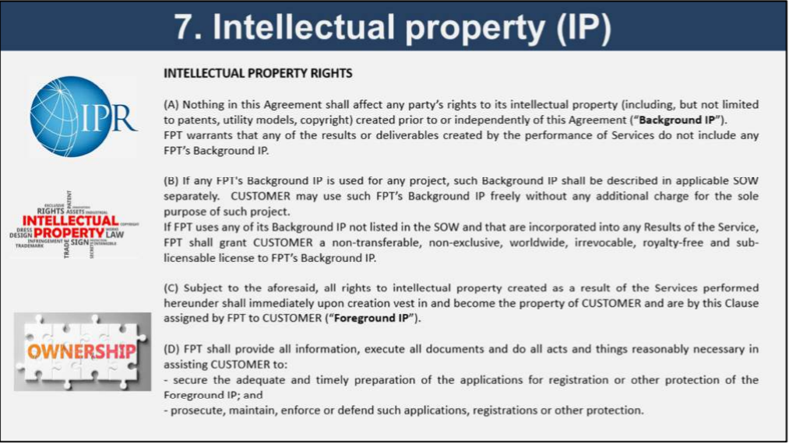
Contract - Other Highlights: Intellectual Property (internal use)
< Add the highlight of contract intellectual property terms in FCMS tool here>
Các điều khoản về sở hữu trí tuệ:
(A) Đoạn A của điều khoản quy định rằng, Fsoft cam kết sản phẩm bàn giao của dự án sẽ không tích hợp các sản phẩm trí tuệ có sẵn.
(B) Đoạn B quy định nếu Fsoft sử dụng các sản phẩm trí tuệ có sẵn của Fsoft vào sản phẩm bàn giao, thì phải mô tả rõ trong SOW.
(C) Đoạn C quy định, tất cả các quyền sở hữu trí tuệ là kết quả thực hiện hợp đồng sẽ thuộc về quyền sở hữu của khách hàng.
(D) Đoạn D quy định Fsoft phải cung cấp các thông tin, ký kết các tài liệu cần thiết để Khách hàng có thể đăng ký bảo hộ quyền sở hữu trí tuệ, hoặc bảo vệ các quyền sở hữu trí tuệ này.

Slide 38
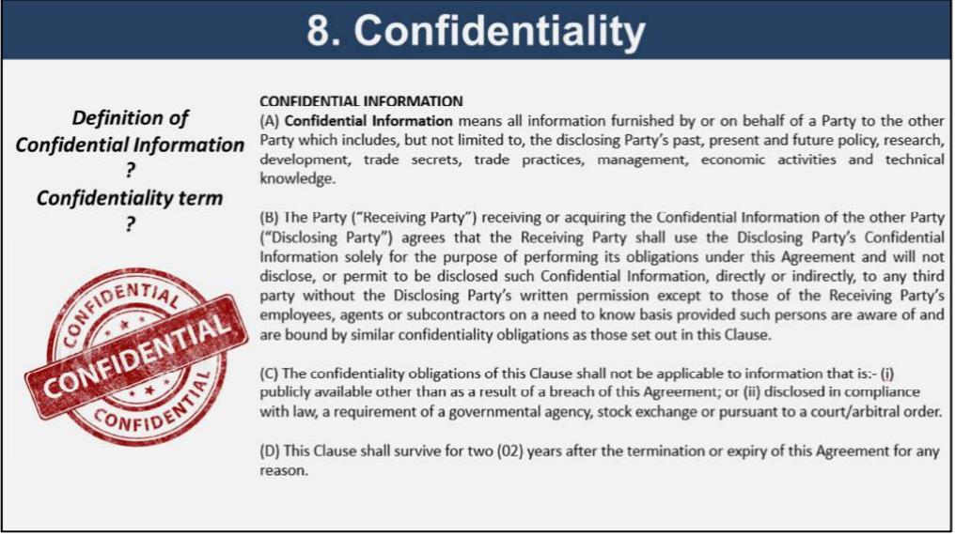
Contract - Other Highlights: Confidentiality (internal use)
< Add the highlight of contract confidentiality terms in FCMS tool here>
Các điều khoản vi phạm bảo mật thông tin:
(A) Đoạn A quy định định nghĩa về Confidential information
(B) Đoạn B quy định về nghĩa vụ bảo mật thông tin
(C) Đoạn C quy định các trường hợp ngoại lệ có thể tiết lộ thông tin mật
(D) Và đoạn D quy định rằng nghĩa vụ bảo mật thông tin sẽ tiếp tục có hiệu lực trong vòng 2 năm kể từ ngày hợp đồng chấm dứt hiệu lực.

Slide 39
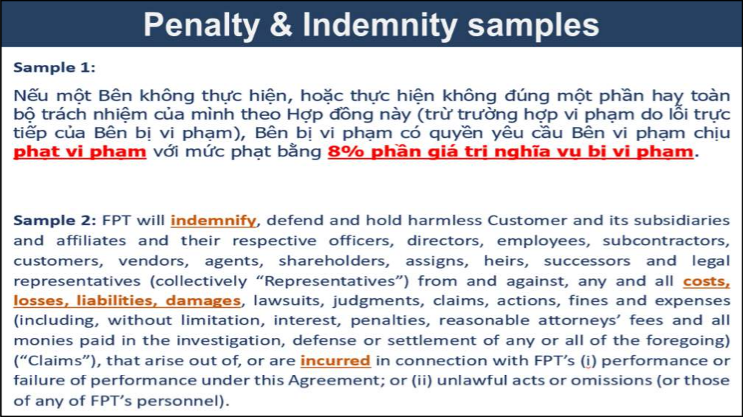
Contract - Other Highlights: Contract Violation (internal use)
< Add the highlight of contract violation terms in FCMS tool here>

Slide 40
APPENDIX
03
Process and
Tools

Slide 41
Daily Task Workflow
According to the status of actual works, team members will drag the tasks through this flow.
TO DO
DOING
UNDER QA
DONE
Task's PIC
Start working
Change assignee
Waiting task
Perform work
Finished work
Change status + logwork
Finished task
End of day
Logwork
Reviewer
Review output
NG output
Change status
Comments?
Output OK
Change status

Slide 42
Bug Fixing Workflow
by
Detector
Open(New)
(DEV/QA menber/Mainline/Supporter)
Register Defects in Detail.
Assigned
(Agile, Mainline, Team Leader)
Assign Proper PIC for Analysis.
Investigating
(Working)
(DEV menber)
Analyzing / Studying Defect by PIC.
FPT Project managers
Resolved
(DEV menber)
Found Root Cause / Countermeasures.
Feature Leaders
Developer PIC
(Sub Status)
Local Only
Internal verification / Check Sub Status
Testers
Released
Applied Countermeasures. Released apk.
Ready to Verify
Main
Sub
NG
OK
Verified
Close
(DEV/QA member/Mainline/Supporter)
Verified Countermeasures.
Basically by detector
Detector

Slide 43
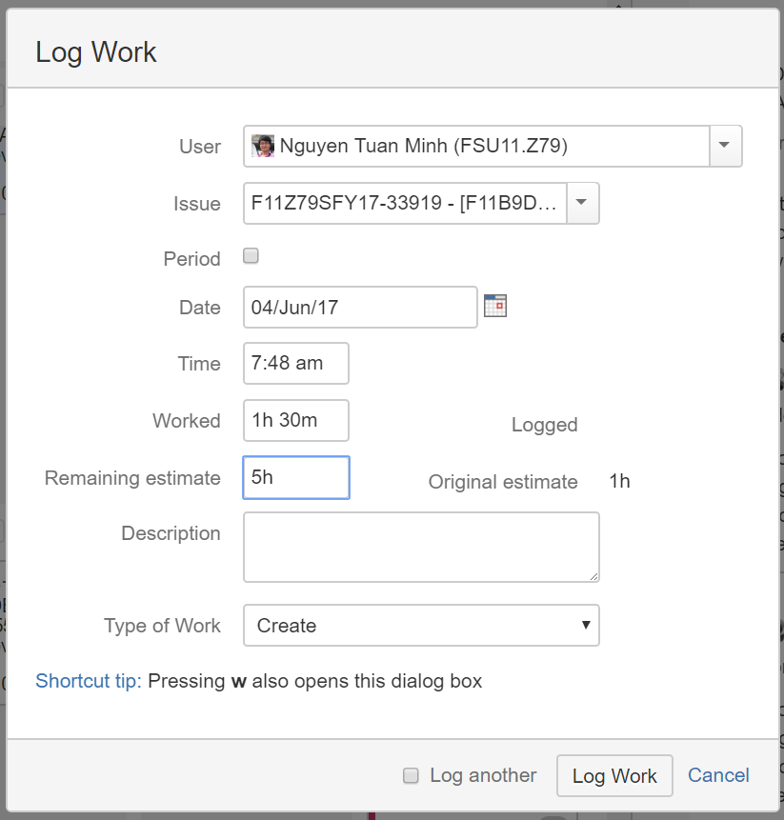
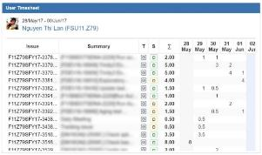
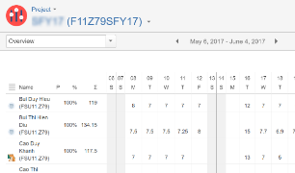
Log Work
Logwork is the MOST IMPORTANT activity. It’s not only logging the spent efforts, but also re-estimating the size of remaining work.
This activity will provide data for calculating progress, spent efforts, remaining efforts, charts….
Today I’ve spent 1h 30min to this task. But I still need more 5hrs to finish it.
Leader MUST REVIEW this data every day.
We can use tempo timesheet to help on tracking it.
Enter the ACTUAL spent efforts to this task.
Leader must review to avoid bad logging data such as (8h, 7h, 4h - ½ day)
Basically, this field is auto-substract by JIRA.
But if the task is not finished. member have to re-estimate the remaining time to complete the task.
If the task is done, it should be 0

Slide 44
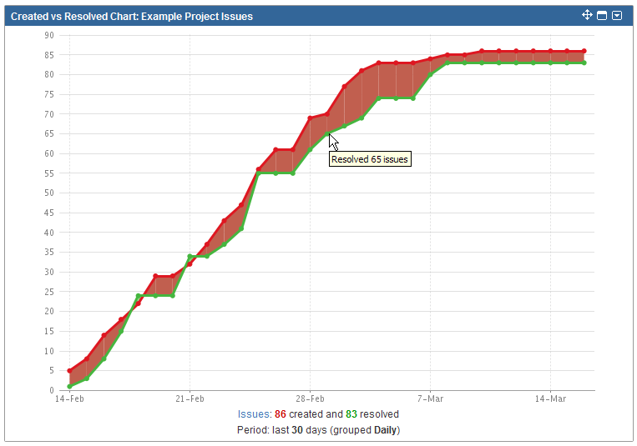
Bug Resolving Status
Created/Resolved Chart of JIRA can help us to analyze the bug detection/resolving speed.
If there’s many detected bugs & team cannot resolve it quickly, the space between these lines (red area) will be a warning for team.
Basically, the overall trends should be a curve like this.
The red line is detected bugs, and green line is resolved bugs. The trends represent the speed of detecting/resolving

Slide 45
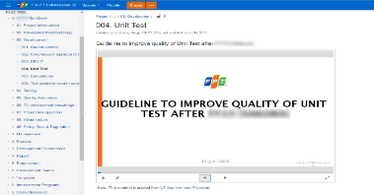
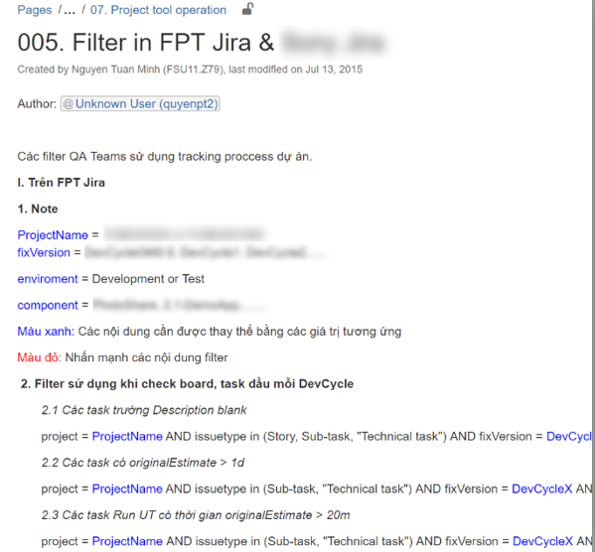
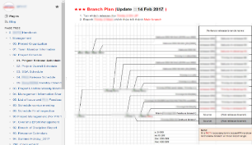

Knowledge Management & Sharing
To control & share the knowledge within project. We use Confluence system.
This is a knowledge management system which centralize all information in the project and make it visible to everybody.
Official documents of project (project plan, organization, management report, etc…)
Official input by customer (requirement, designs, attention notes…)
Official released packages & it’s information (version, changelog, date…)
Collaboration place of each team (daily meetings, retrospective meetings, other meeting notes…)
Server & infrastructure configuration information
Handbook for common knowledge in project’s business area.
Official project processes

Slide 46
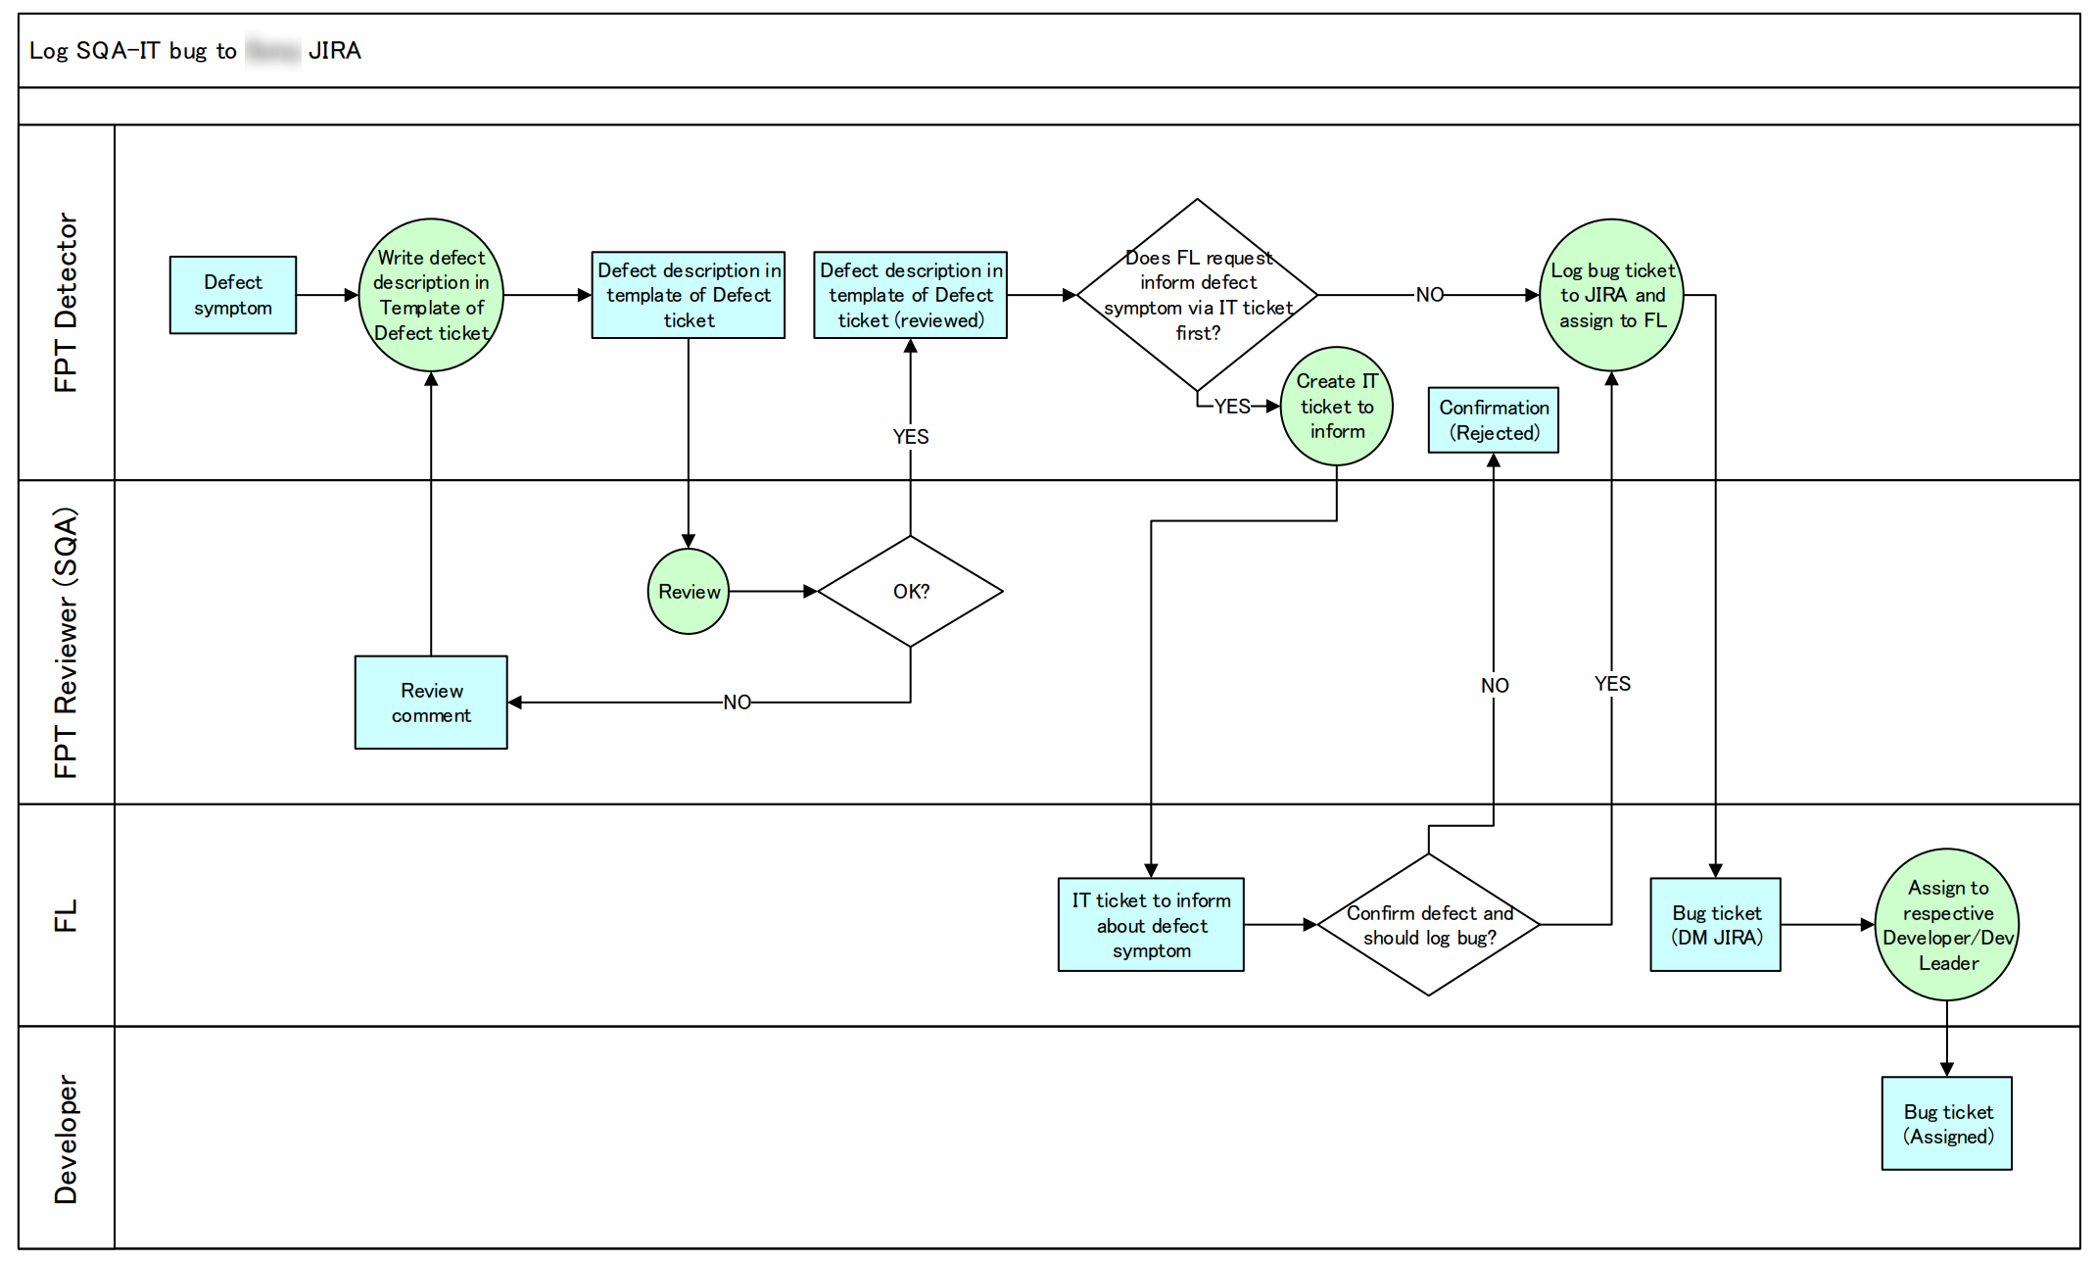
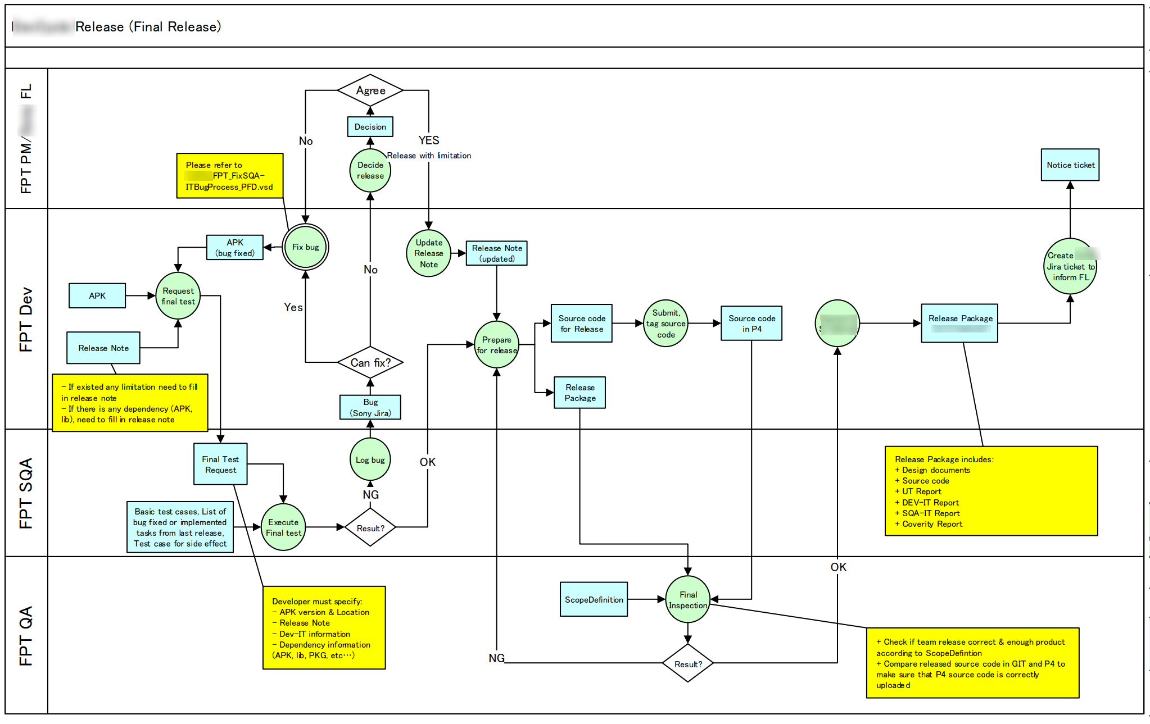
Knowledge Management & Sharing
All project processes will be documented in PFD (Process Flow Diagram) format and keep in Confluence system. So it’s easy to transfer, training and refer it to all members.
Feature implementation process (design, coding, reviewing, Unit Test, Developer IT…)
Defect logging process
Defects resolving process
Information reporting process
Communication ticket resolving process
Equipment import/export process
New member training process
Etc…

Slide 47
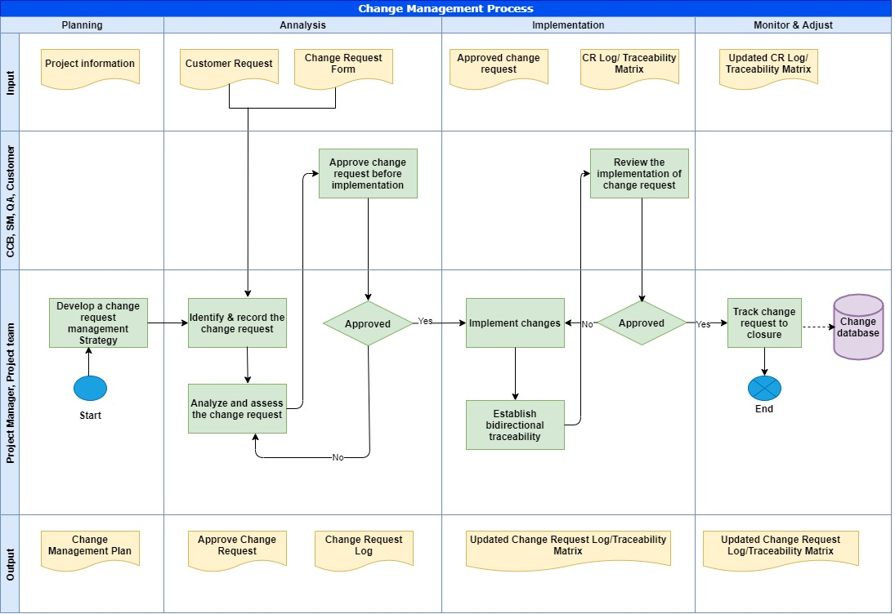
Change Management
All changes to a service or service component incurs additional costs during system development must be raised using a request for change (RFC) and approved before implementation. Back-out plan must be clearly validated before implement change.

Slide 48











Engineering Processes
Source control & review
Continuous Integration
Daily Unit Test
Static
Analysis
Automated Packaging
Reviewer
Release package
Source commit
Developer IT
Tester
Developer
Customer
Automation Test

Slide 49
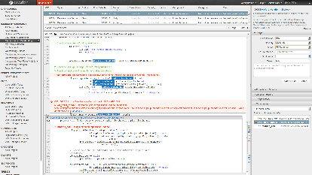
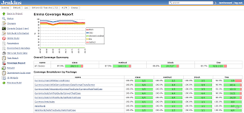
Continuous Integration System
Build
Static Analysis
Detect the build break by rolling build.
Create the daily PKG file for Unit Test.
Detect the potential issues by Coverity/Blackduck/Sonar
Phase
Packaging
Immediately create release package for every commit.
Prevent the human mistake when creating release package.
Unit Test
Execute Unit Test every day to find logic issues.
Daily Execution

Slide 50
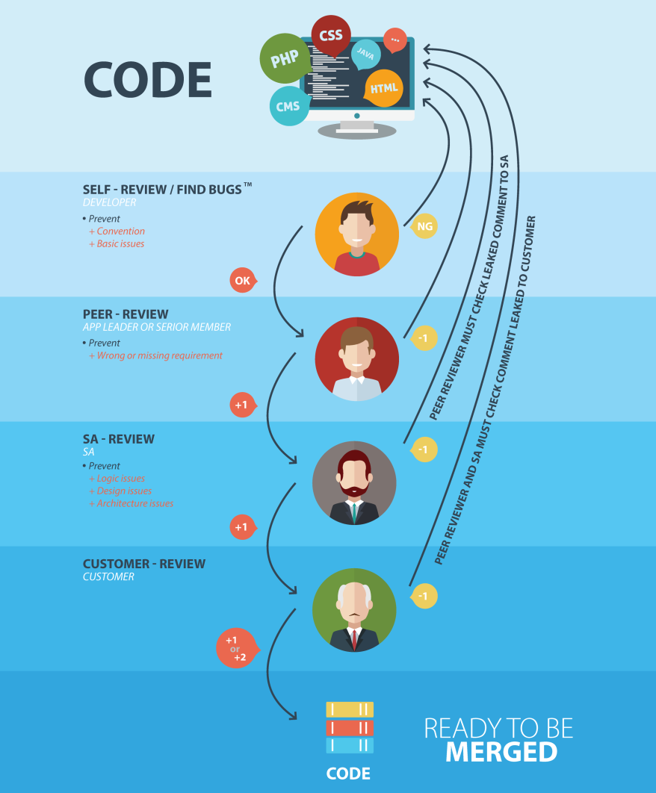
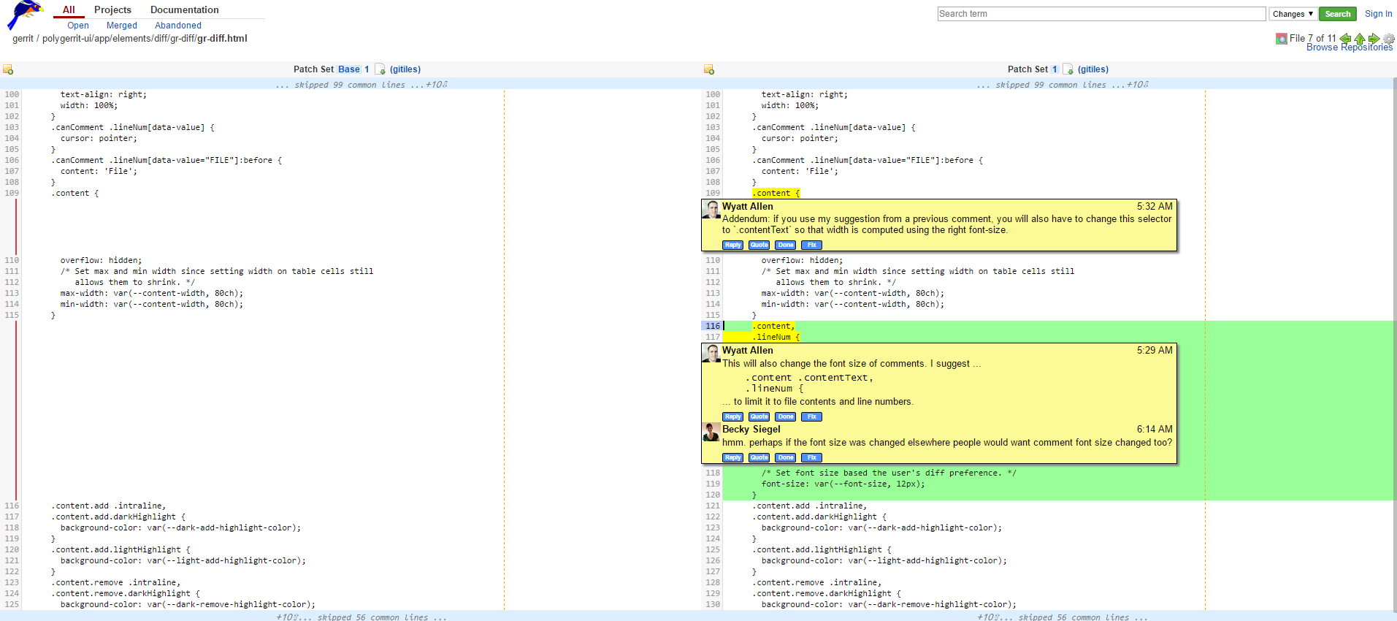
Code Review Process
Improve the quality of every commit by different review process. We use Bitbucket tool for Developer-Reviewer collaboration.

Slide 51
















Software & Tools
Type | Tools
IDE & Language
Source Code Management
Testing & Static Analysis
CI/CD
Management
Communication

Slide 53
Thank You!

